Slide 1
Digital Portfolio
STUDENT NAME: N.Thamizhselvan
REGISTER NO AND NMID: 212402446 /981E117878B135896B94054D52D082A6
DEPARTMENT: BCA
COLLEGE: Agurchand Manmull Jain College
UNIVERSITY: Madras university

Slide 2
PROJECT TITLE
Digital Portfolio

Slide 3


AGENDA
Problem Statement
Project Overview
End Users
Tools and Technologies
Portfolio design and Layout
Features and Functionality
Results and Screenshots
Conclusion
Github Link
3/21/2024 Annual Review

Slide 4

PROBLEM STATEMENT
The need for a professional portfolio website to showcase projects, skills, and education. A personal website highlights capabilities and serves as a resume alternative for career opportunities.

Slide 5

PROJECT OVERVIEW
A responsive portfolio website developed using HTML, CSS, and JavaScript. It includes sections such as About Me, Projects, Education, and Contact.

Slide 6

WHO ARE THE END USERS?
• Recruiters and hiring managers
• Potential clients
• Peers and collaborators
• Academic institutions

Slide 7

TOOLS AND TECHNIQUES
• HTML5
• CSS3
• JavaScript
• GitHub for version control and Vs code

Slide 8
POTFOLIO DESIGN AND LAYOUT
• Modern, clean, and responsive design
• Sections: About, Projects, Education, Contact
• Navigation bar for easy access
• Minimalistic color scheme for readability
8

Slide 9
FEATURES AND FUNCTIONALITY
• Responsive across devices
• About Me with profile details
• Project descriptions with tech stack
• Education details
• Contact links (Email, GitHub)
• Weather App integration using API

Slide 10
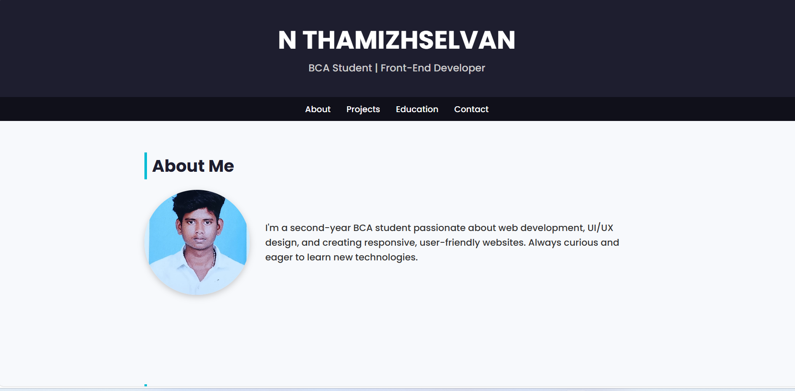

RESULTS AND SCREENSHOTS
The portfolio website is fully functional and showcases projects effectively.
3/21/2024 Annual Review
10

Slide 11
CONCLUSION
The portfolio website serves as a digital resume and project showcase, enhancing visibility to recruiters and clients. It highlights skills in front-end development .
11

Slide 12
GITHUB LINK
https://github.com/thamizhselvan24h006/protfiolio006.git

